Slide 1

Prediction of Medical
Insurance Cost
Group A
PoAn Chen, Zhongwei Wang,
Yibing Chen
Predictive Modeling
Professor： Lina Xu
04/26/2022

Slide 2
Distribution of Labor
Project Introduction
Data Overview
Best Select
Ridge & Lasso
Decision Tree
Random Forest & Boosting
Conclusion
Data Overview: Zhongwei Wang
Data Visualization: Yibing Chen
Best Select: Yibing Chen
Ridge & Lasso: Zhongwei Wang
Decision Tree: Po An Chen
Random Forest & Boosting: Po An Chen
Conclusion: Po An Chen&Zhongwei Wang

Slide 3
Data Overview
Project Introduction
Data Overview
Best Select
Ridge & Lasso
Decision Tree
Random Forest & Boosting
Conclusion
Target
Charges | How much health insurance premiums cost
Age | Age of primary beneficiary
Sex | Insurance contractor gender, female, male
BMI | Body mass index
Smoker | Smoking
Children | Number of children covered by health insurance
Region | The beneficiary’s residential area in the U.S, northeast, southeast, southwest, northwest
Predictors

Slide 4
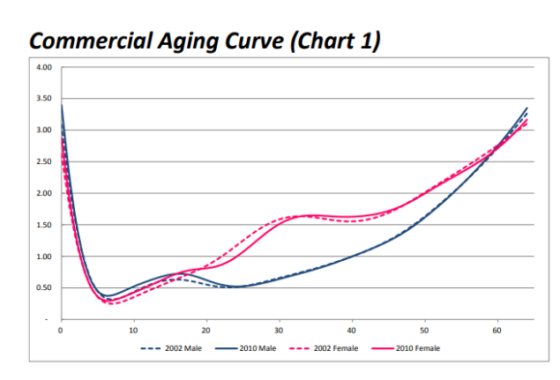
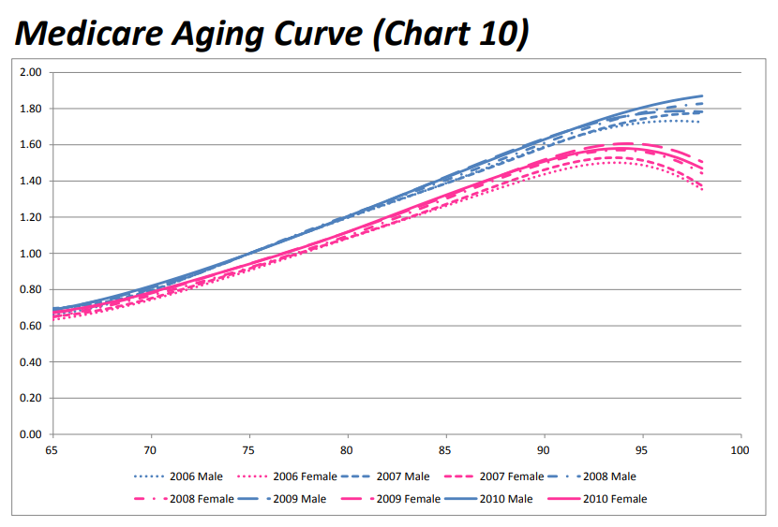
Data Overview
Project Introduction
Data Overview
Best Select
Ridge & Lasso
Decision Tree
Random Forest & Boosting
Conclusion
Age&Sex
Medicare cost increases with age with some exceptions
Relatively high and gradually decrease from 2 to 5
Male: Declines between 15 to 25 years old
Female: Stable between 30- to 40 years old
https://www.soa.org/globalassets/assets/files/research/projects/research-health-care-birth-death-report.pdf

Slide 5
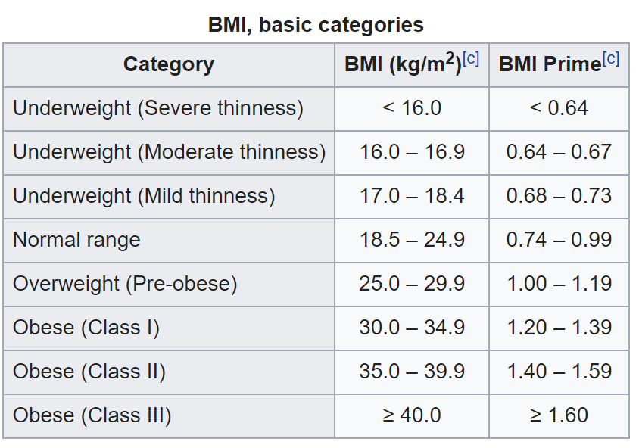
Data Overview
Project Introduction
Data Overview
Best Select
Ridge & Lasso
Decision Tree
Random Forest & Boosting
Conclusion
BMI(Body mass index)
Weight divided by height squared (kg/m^2)
Normal range: 18.5 - 24.9
Too high or too low will lead to an increase in medicare expense
https://en.wikipedia.org/wiki/Body_mass_index

Slide 6
Data Overview
Project Introduction
Data Overview
Best Select
Ridge & Lasso
Decision Tree
Random Forest & Boosting
Conclusion
Medicare expense
Smoker:
Smoker > Non-Smoker
Number of children:
More children usually result in more Medicare cost
Region:
Regional differences may lead to differences in medical spending

Slide 7
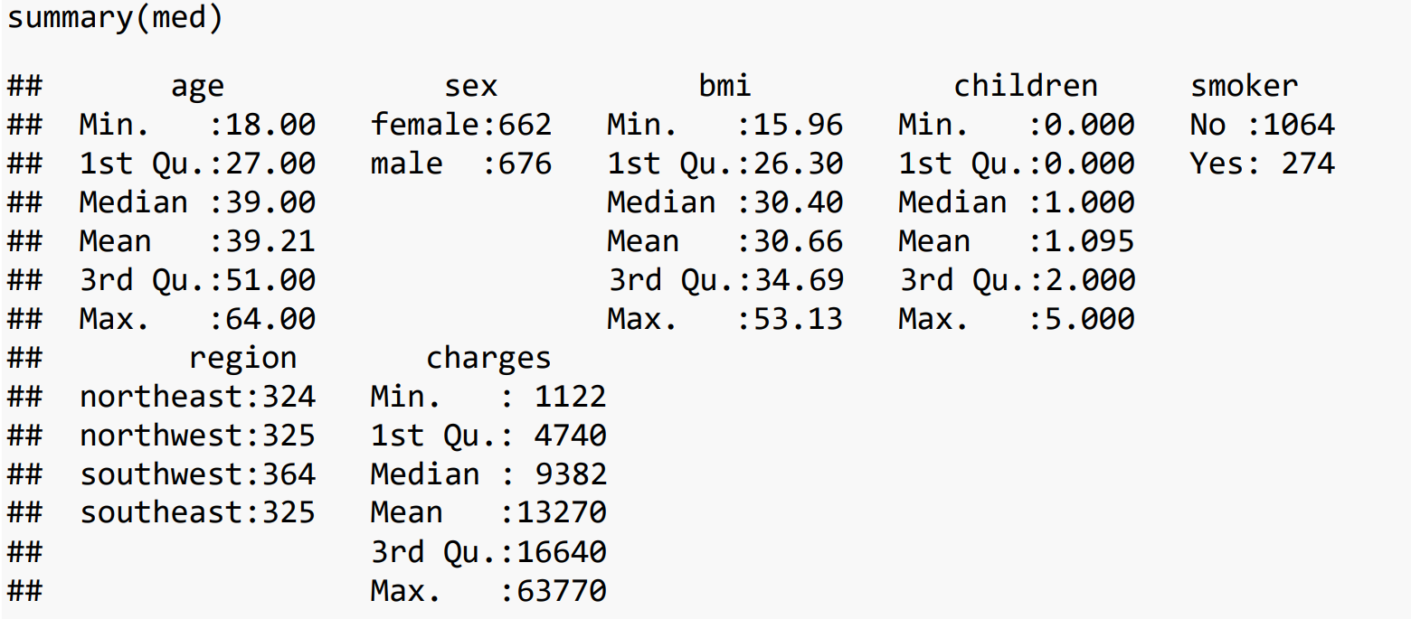
Summary of Data
Project Introduction
Data Overview
Best Select
Ridge & Lasso
Decision Tree
Random Forest & Boosting
Conclusion

Slide 8
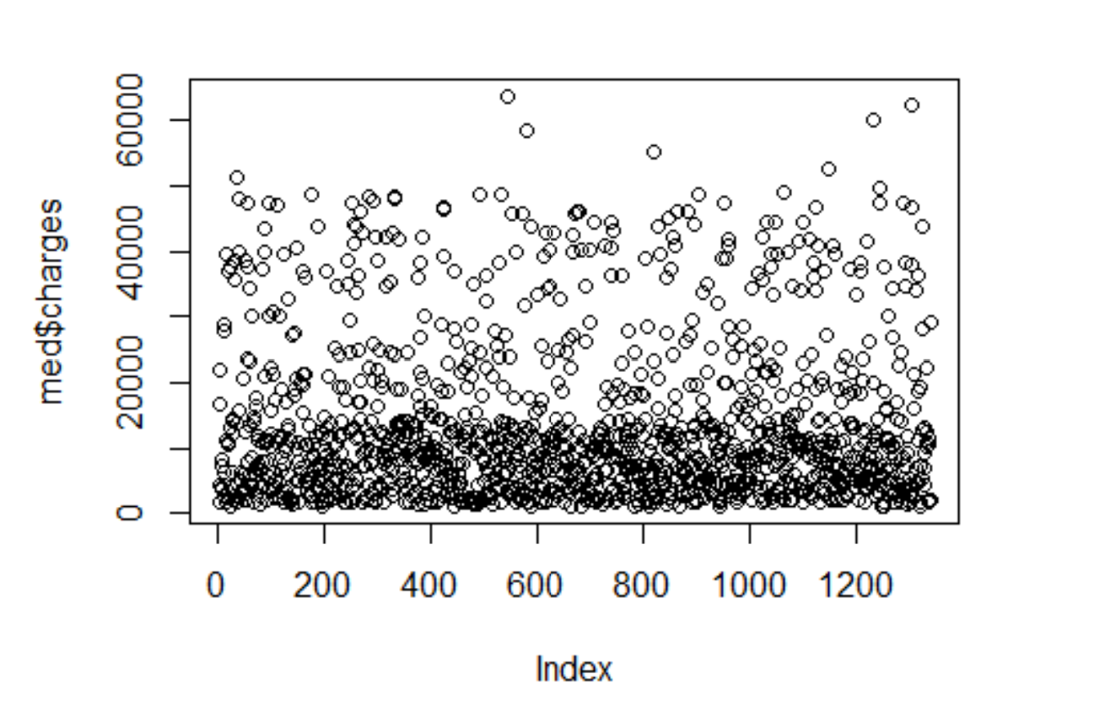
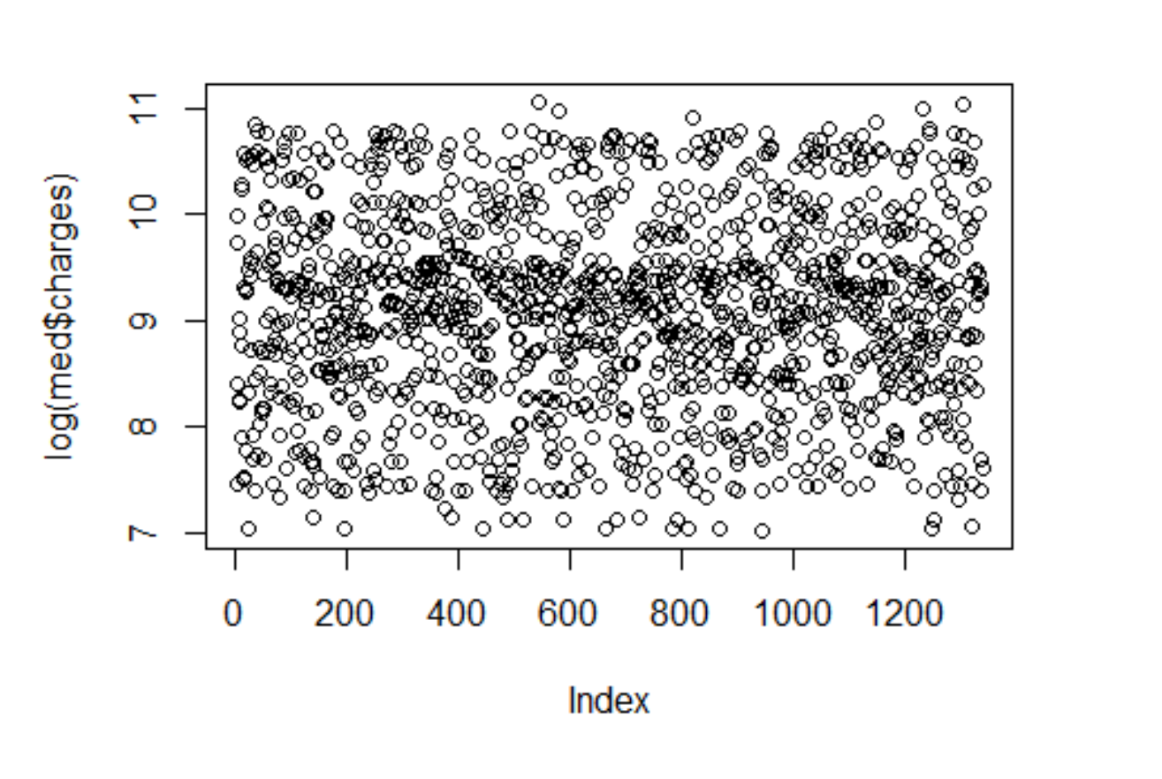
Data Visualization
Project Introduction
Data Overview
Best Select
Ridge & Lasso
Decision Tree
Random Forest & Boosting
Conclusion

Slide 9
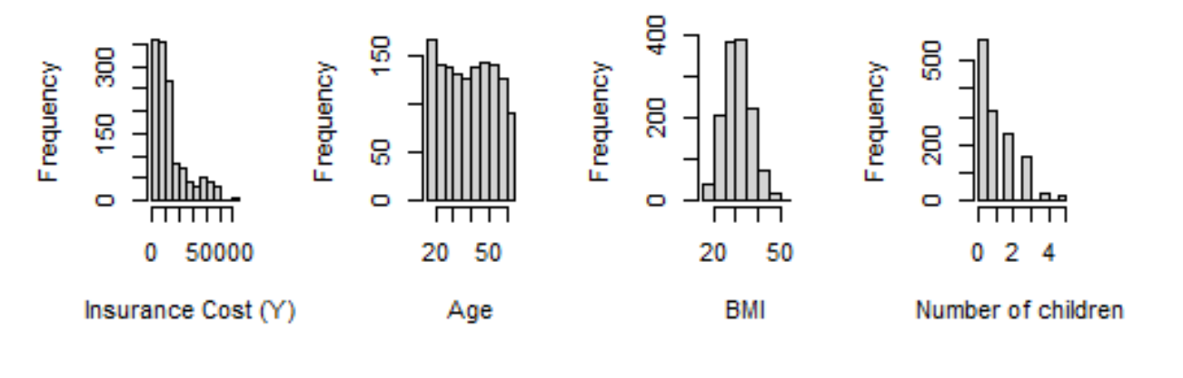
Data Visualization
Project Introduction
Data Overview
Best Select
Ridge & Lasso
Decision Tree
Random Forest & Boosting
Conclusion

Slide 10
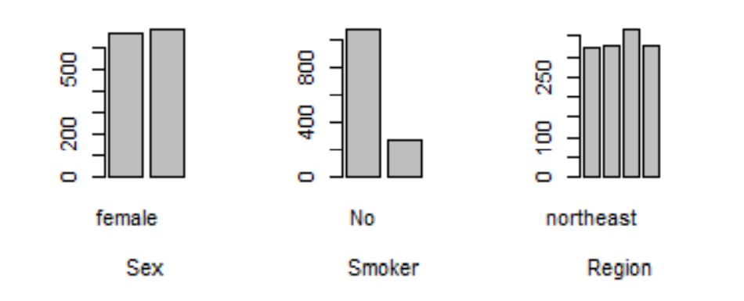
Data Visualization
Project Introduction
Data Overview
Best Select
Ridge & Lasso
Decision Tree
Random Forest & Boosting
Conclusion

Slide 11
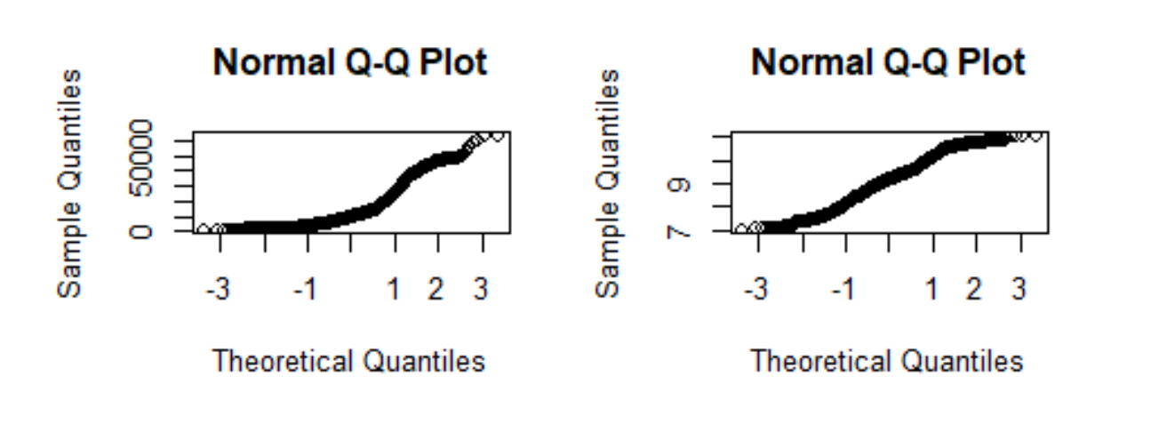
Data Visualization
Project Introduction
Data Overview
Best Select
Ridge & Lasso
Decision Tree
Random Forest & Boosting
Conclusion

Slide 12
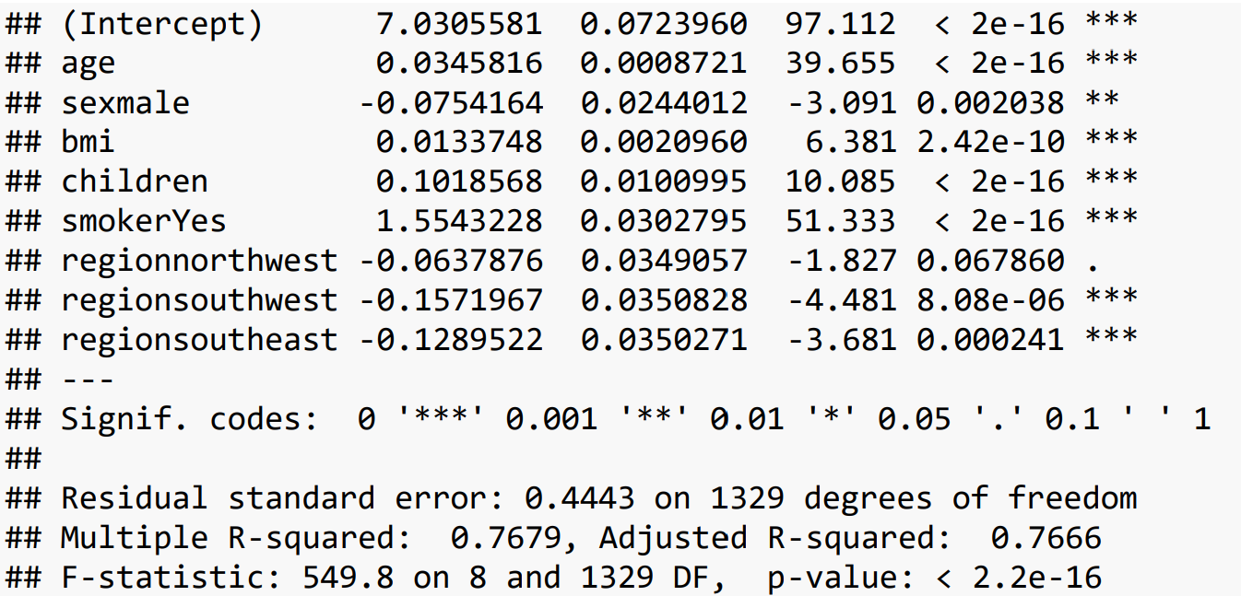
Fitting Model
Project
Introduction
Data Overview
Best
Select
Ridge & Lasso
Decision Tree
Random Forest & Boosting
Conclusion

Slide 13
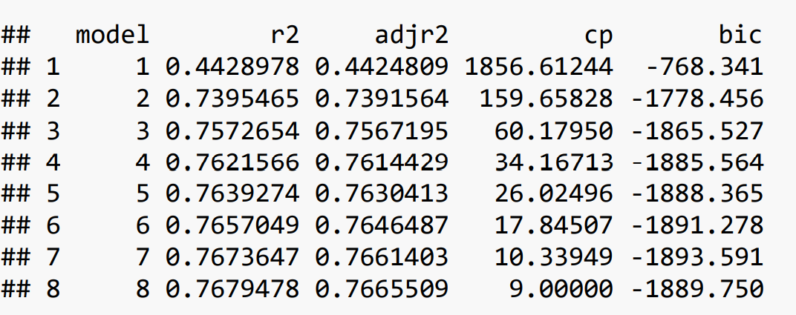
Model Selection
Project
Introduction
Data Overview
Best
Select
Ridge & Lasso
Decision Tree
Random Forest & Boosting
Conclusion
Full dataset

Slide 14
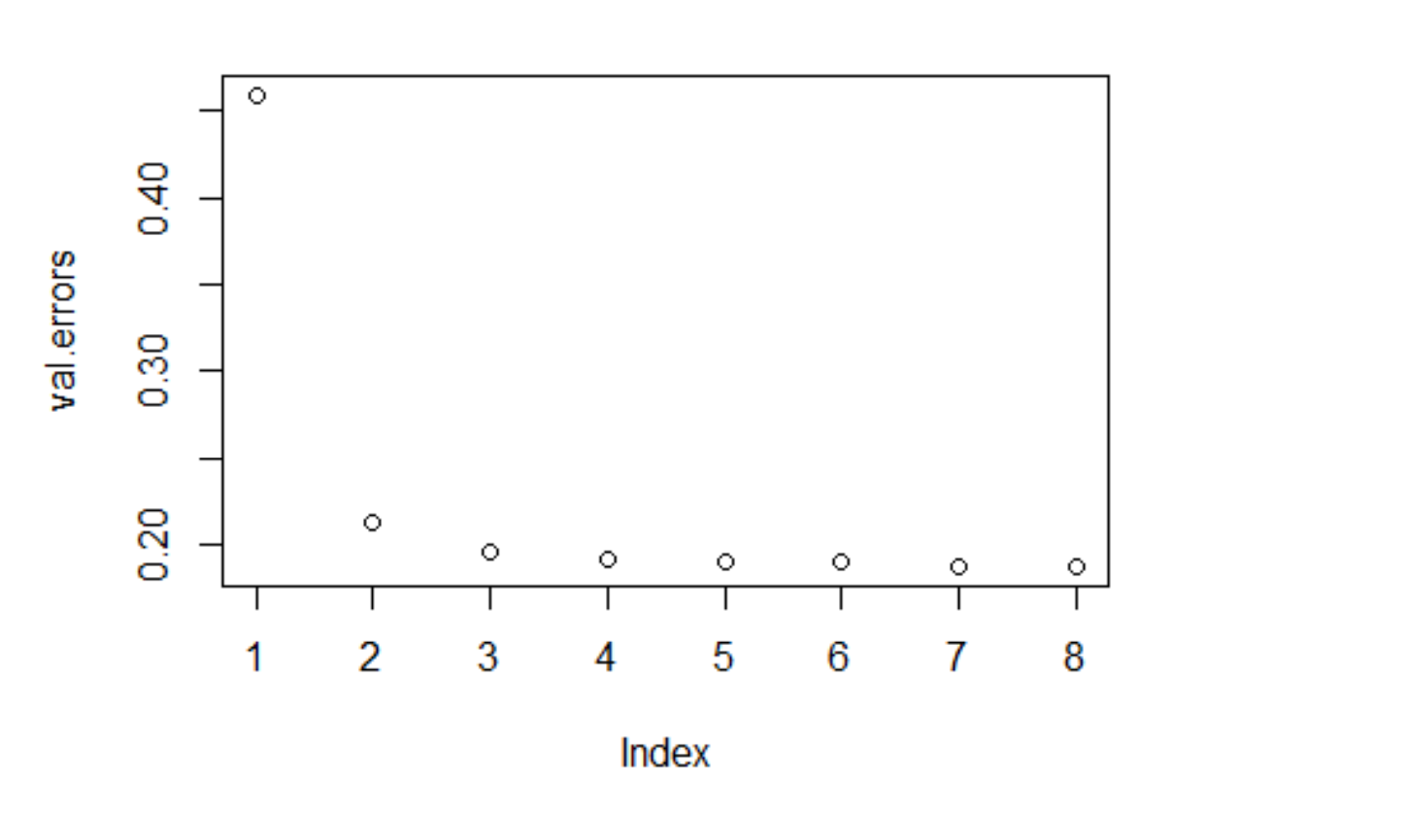
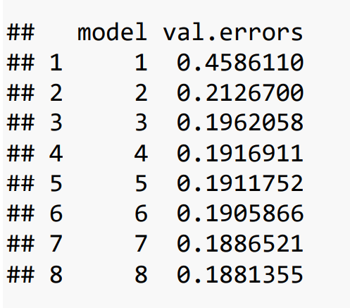
Model Selection
Project
Introduction
Data Overview
Best
Select
Ridge & Lasso
Decision Tree
Random Forest & Boosting
Conclusion
Train-test splitting methods

Slide 15
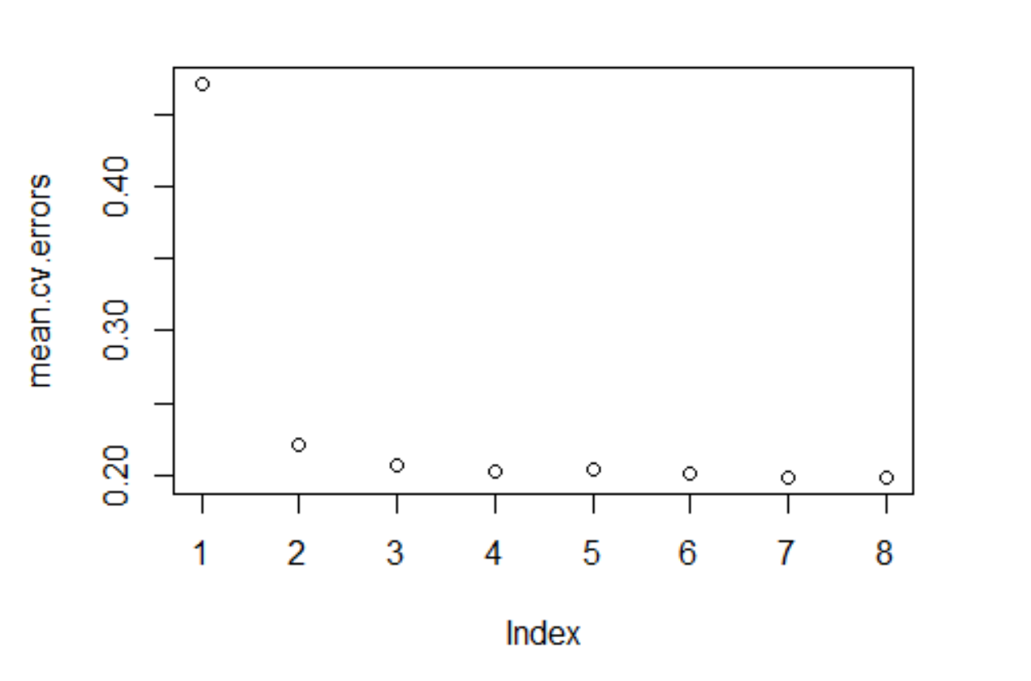
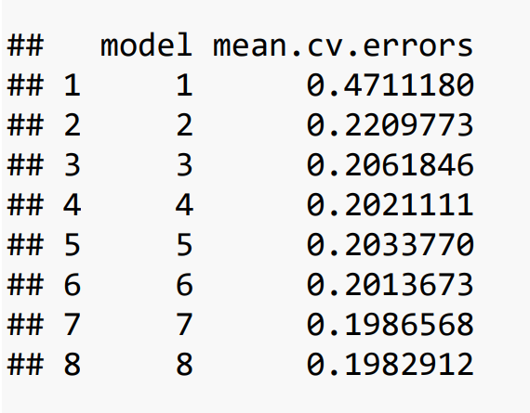
Model Selection
Project
Introduction
Data Overview
Best
Select
Ridge & Lasso
Decision Tree
Random Forest & Boosting
Conclusion
Cross validation method
10-fold

Slide 16
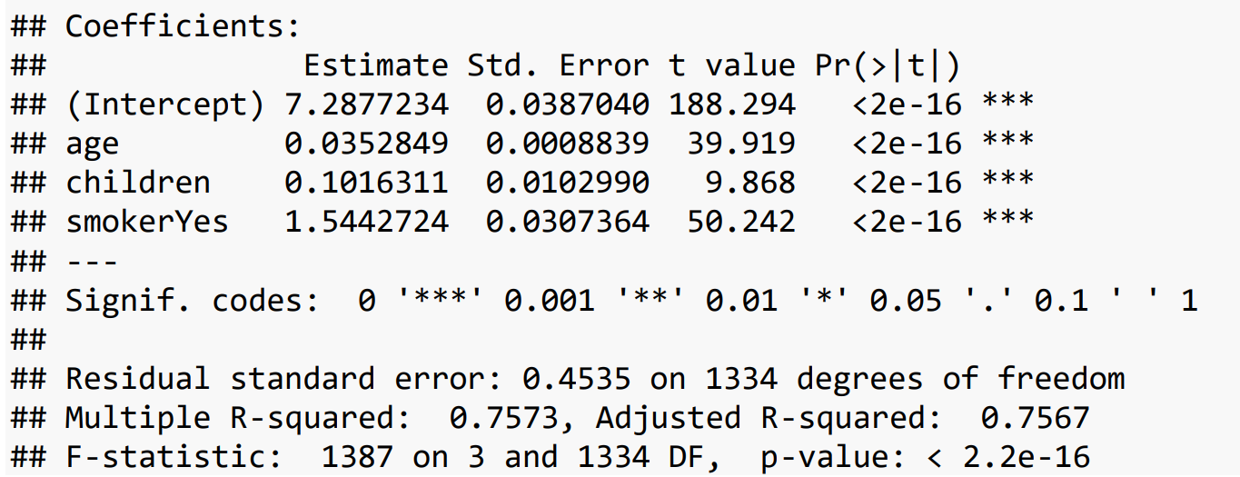
Model Selection
Project
Introduction
Data Overview
Best
Select
Ridge & Lasso
Decision Tree
Random Forest & Boosting
Conclusion

Slide 17
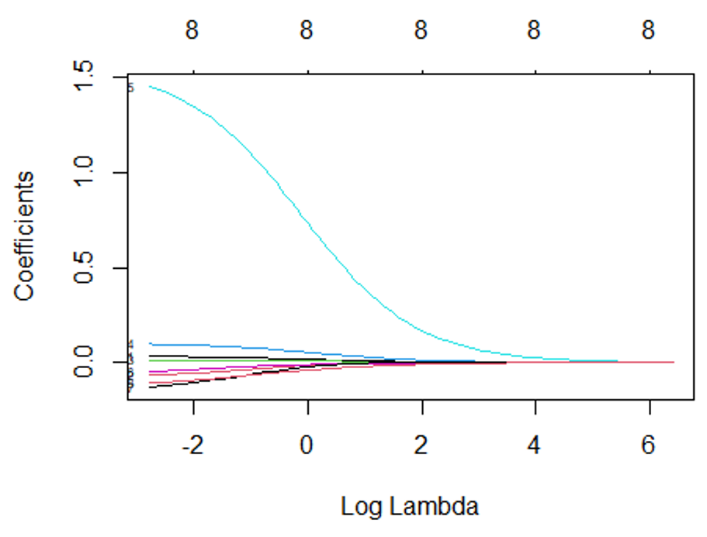
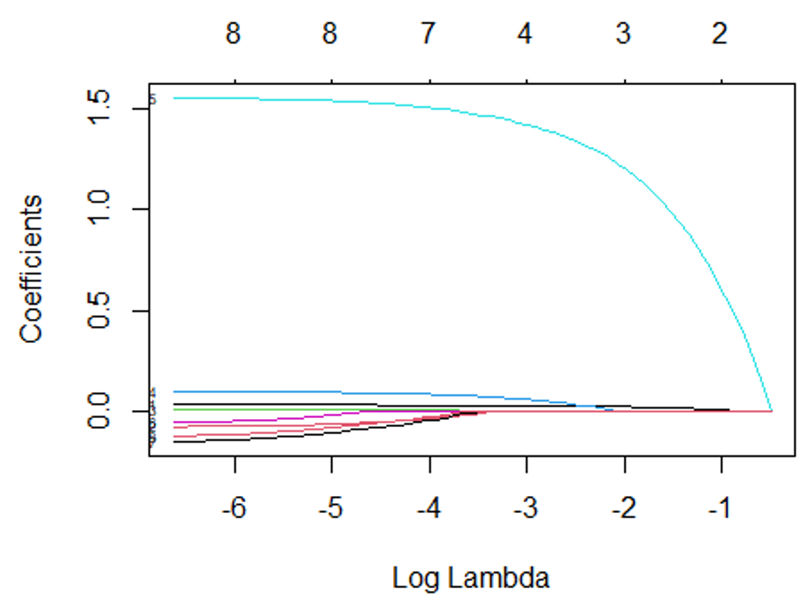
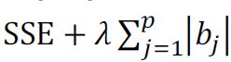
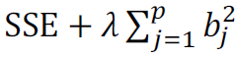
Ridge & Lasso
Project
Introduction
Data Overview
Best
Select
Ridge & Lasso
Decision Tree
Random Forest & Boosting
Conclusion

Slide 18
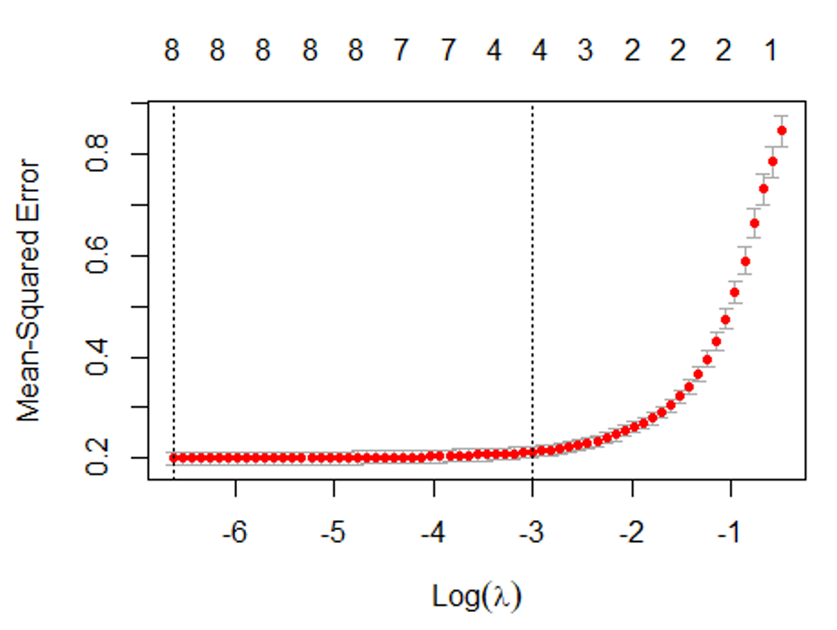
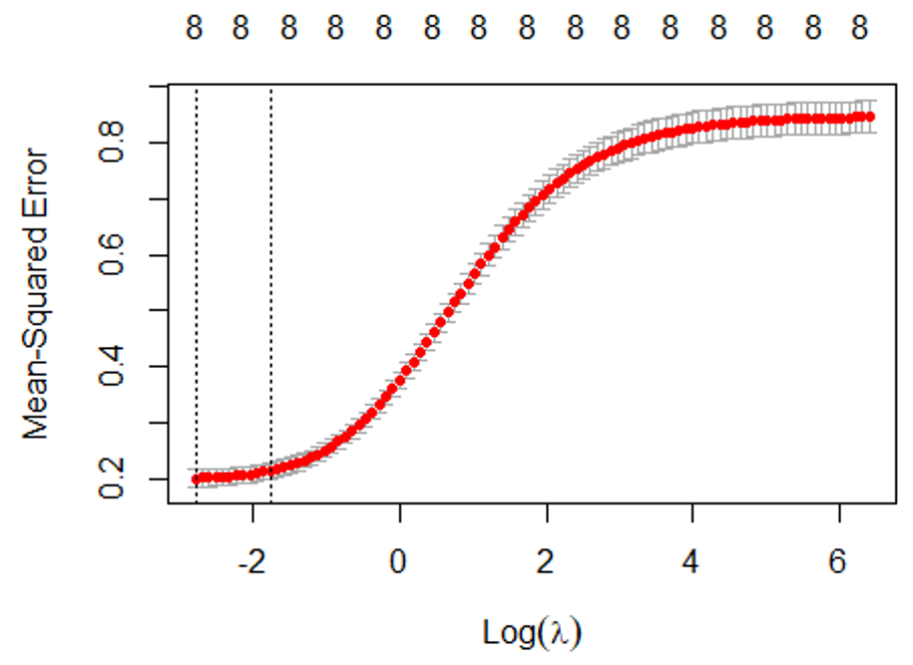
Ridge & Lasso
Project
Introduction
Data Overview
Best
Select
Ridge & Lasso
Decision Tree
Random Forest & Boosting
Conclusion

Slide 19
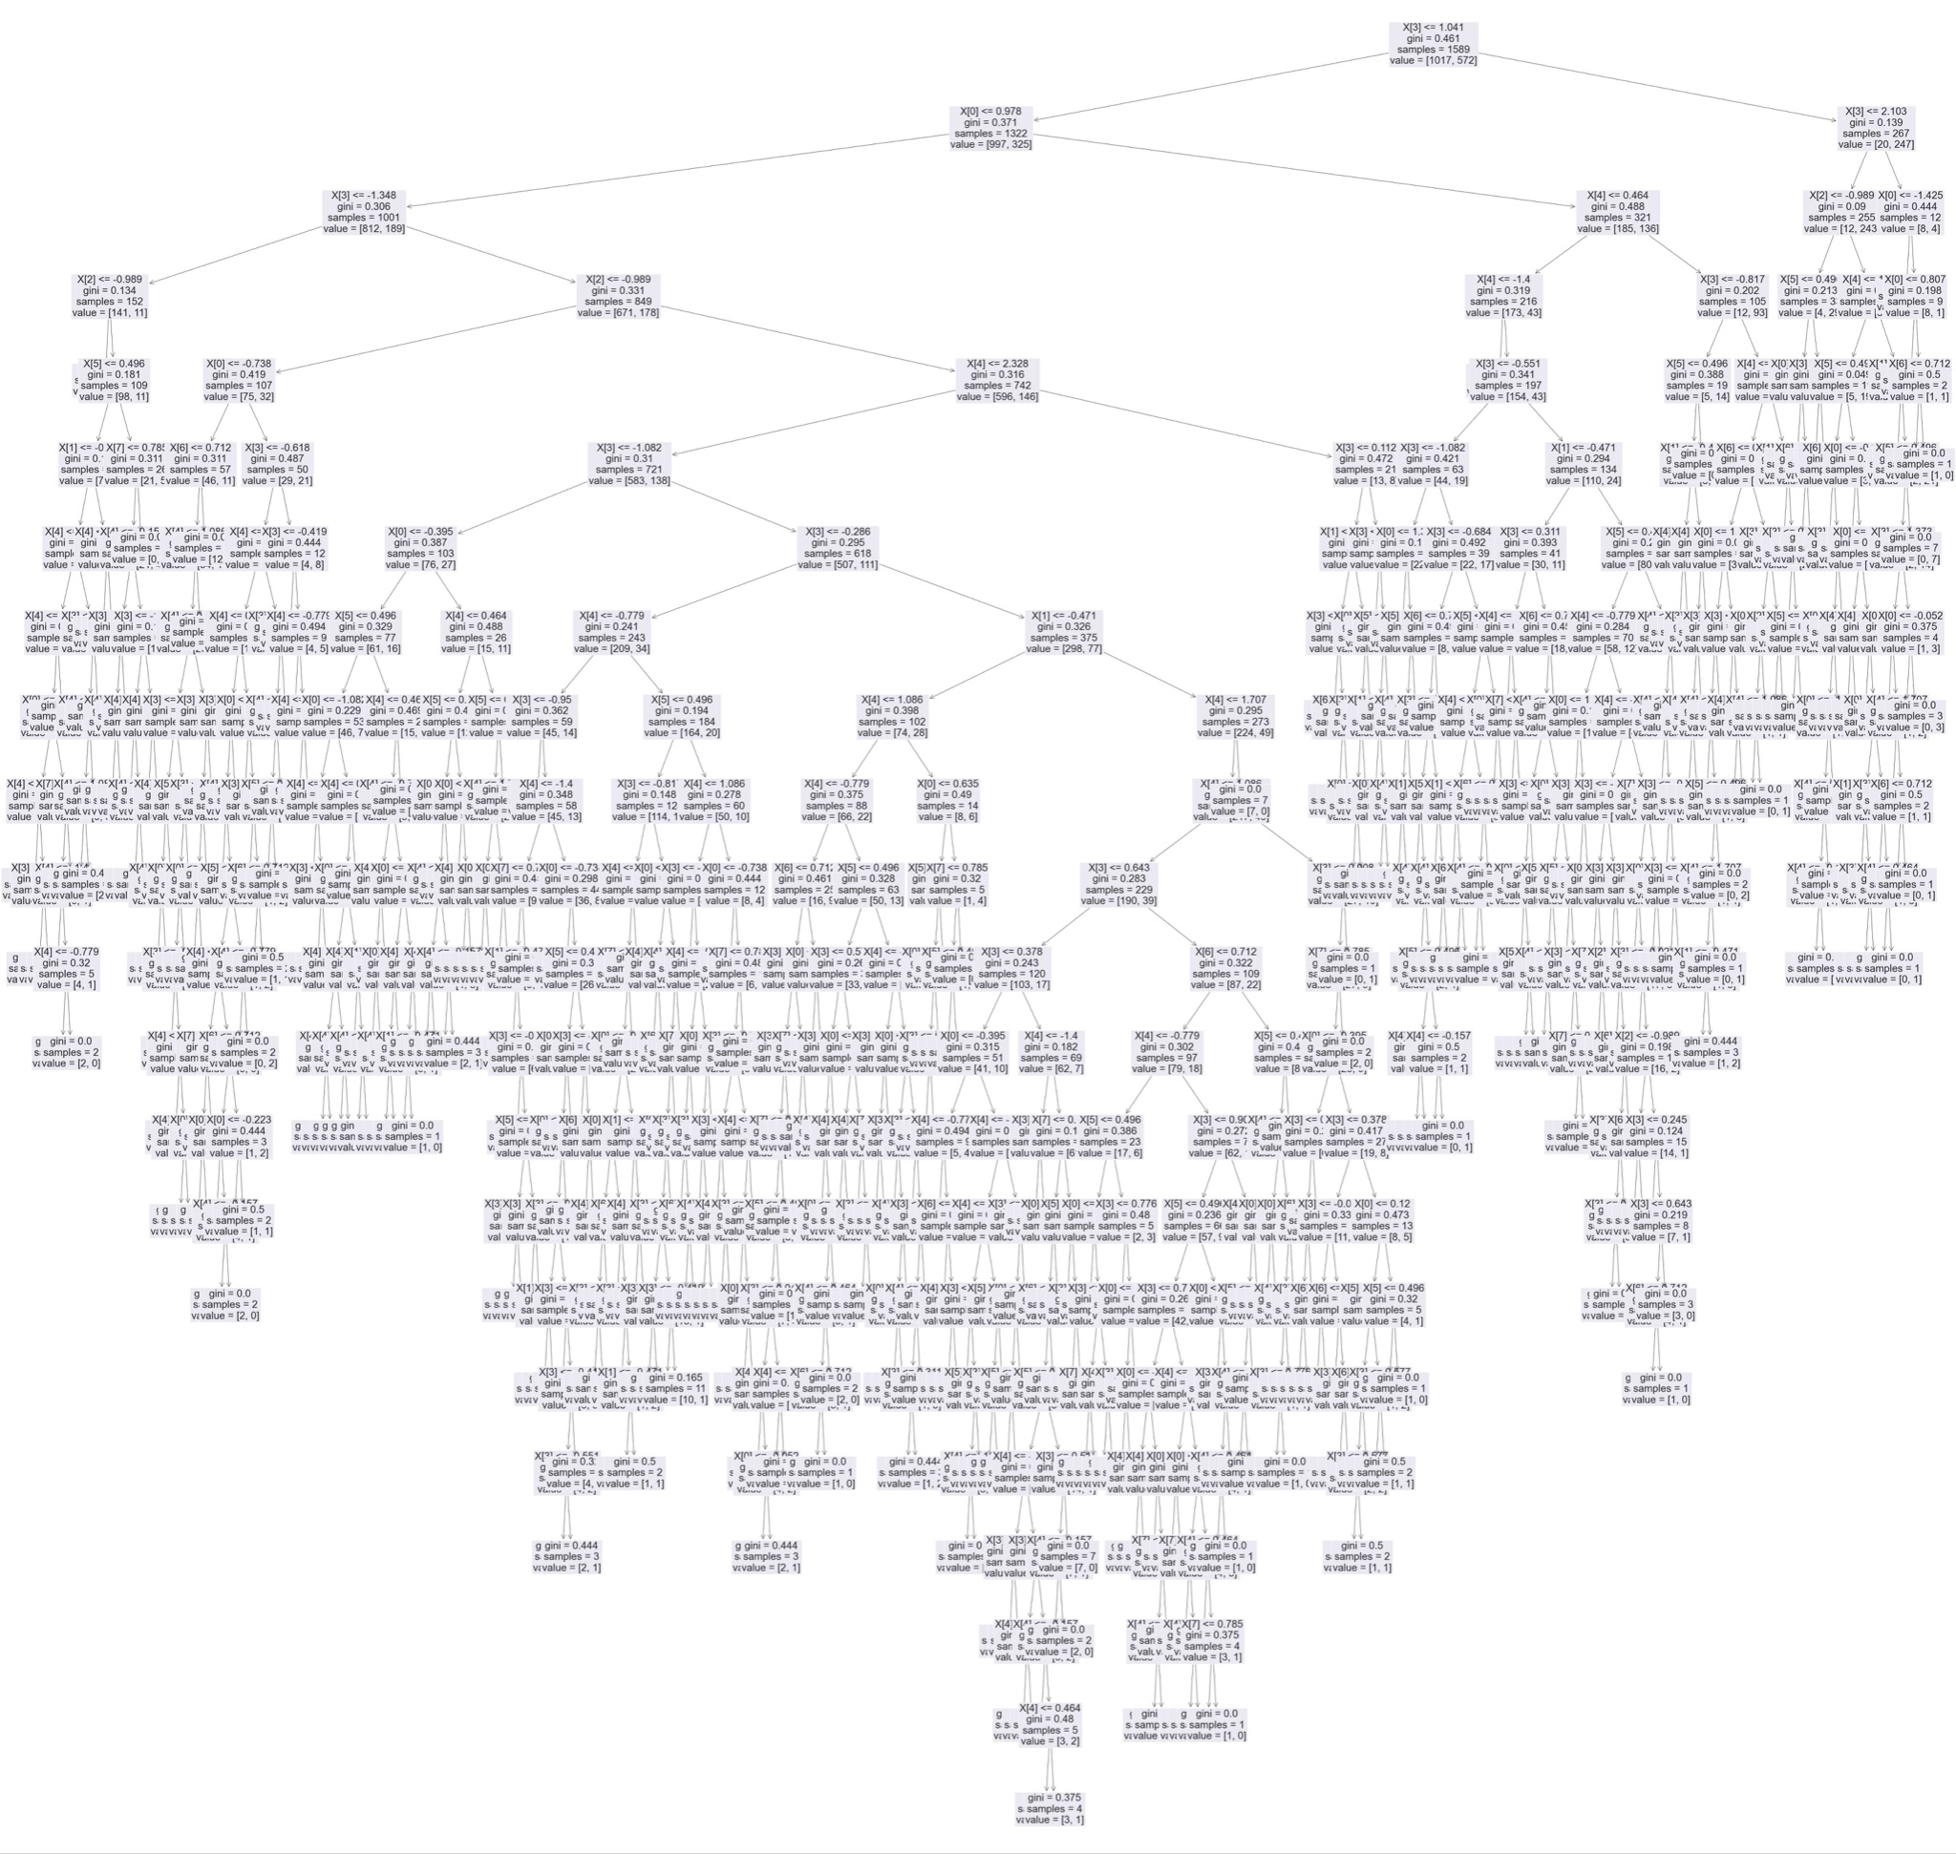
Decision Tree
Project Introduction
Data Overview
Best Select
Ridge & Lasso
Decision Tree
Random Forest & Boosting
Conclusion
• Recursive binary splitting process that splits data into a finite set of non-overlapping regions.
• Pro: easy to interpret and display; no probability distribution assumption
• Con: vulnerable to overfitting.
• test MSE: 0.2464

Slide 20
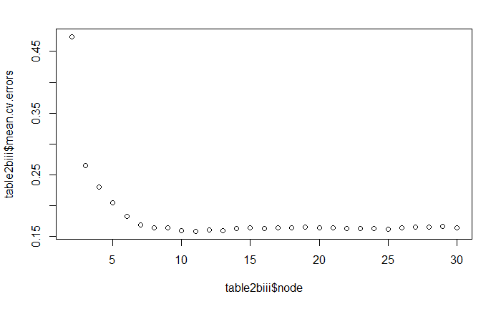
Pruned Decision Tree
Project Introduction
Data Overview
Best Select
Ridge & Lasso
Decision Tree
Random Forest & Boosting
Conclusion
1
• Pruning is necessary to reduce the size of a tree and remove less valuable splits.
• Pro: reduces overfitting and can lead to a simpler, more interpretable tree; automatically performs variable selection.
• Using Cross Validation to find the best pruned tree, n=11
n=11, min mean(CV error)

Slide 21
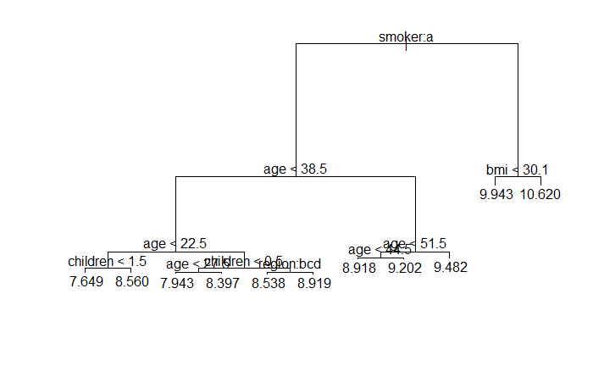
Pruned Decision Tree
Project Introduction
Data Overview
Best Select
Ridge & Lasso
Decision Tree
Random Forest & Boosting
Conclusion
• Using Cross Validation to find the best pruned tree, n=11
• test MSE: 0.1890

Slide 22
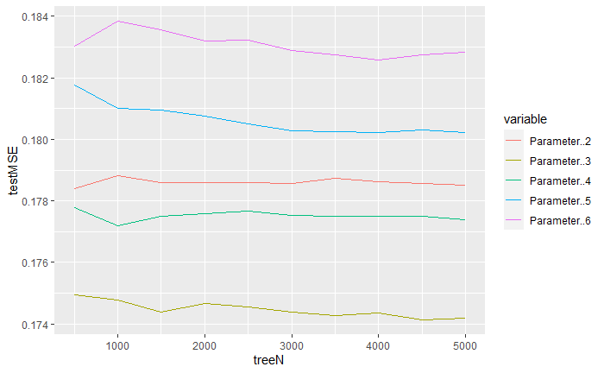
Random Forest
Project Introduction
Data Overview
Best Select
Ridge & Lasso
Decision Tree
Random Forest & Boosting
Conclusion
Bagging
• Combines the results of a set of decision trees fitted to a different bootstrapped sample of the training data, then using the average to make a final prediction.
• Pro: reduces overfitting and variance of the base tree, leading to higher prediction accuracy.
• Con: loses the interpretability of decision trees and is computationally intensive.
• Randomly select 3 parameter and build 4500 trees -> minimum MSE
p=3, min(MSE)

Slide 23
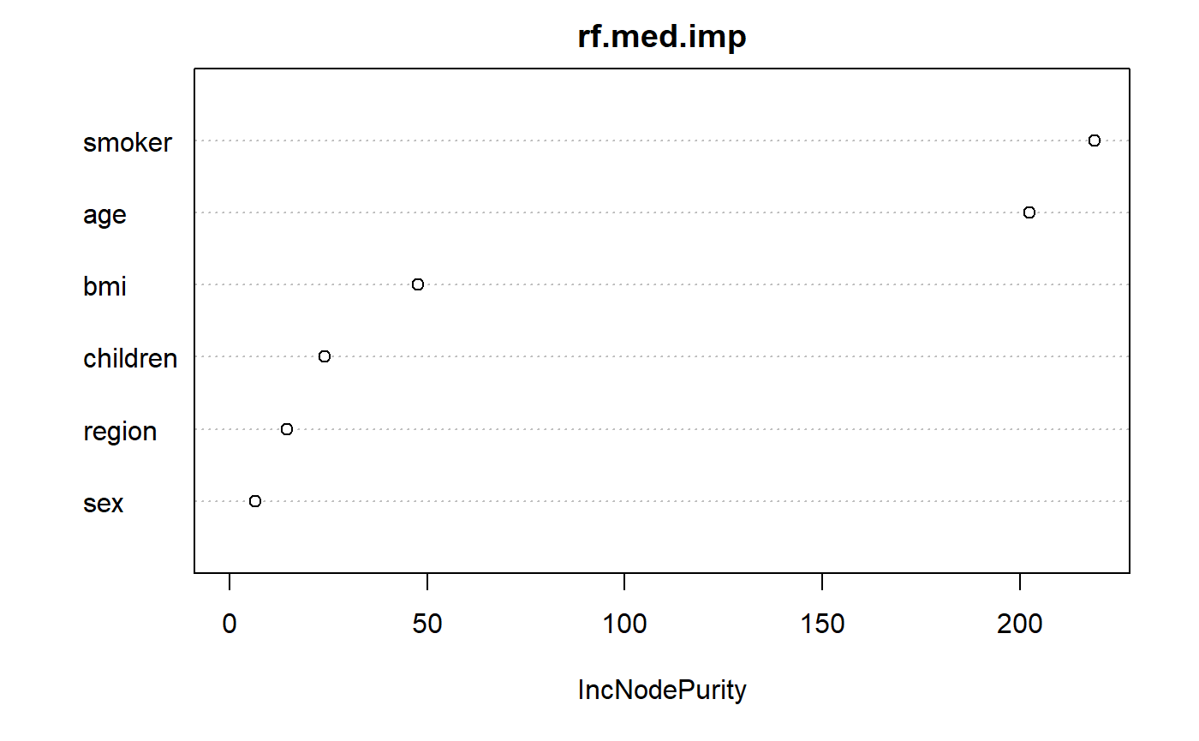
Random Forest
Project Introduction
Data Overview
Best Select
Ridge & Lasso
Decision Tree
Random Forest & Boosting
Conclusion
• Variable importance
• smoker, age
• The result is same as the best selection in the linear regression model with p=2.

Slide 24
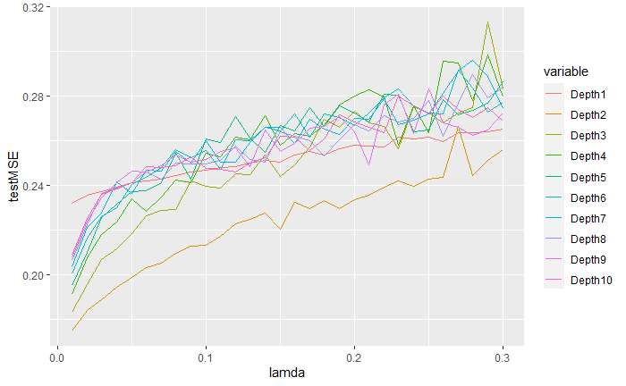
Gradient Boost Trees
Project Introduction
Data Overview
Best Select
Ridge & Lasso
Decision Tree
Random Forest & Boosting
Conclusion
• The boosting approach learns slowly controlled by shrinkage parameter 𝜆.
• Given the current model, boosting fit a decision tree to the residuals from the model.
• Lamda=0.01 has the smallest test MSE in each Depth.

Slide 25
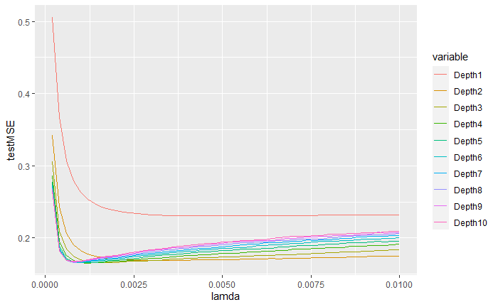
Gradient Boost Trees
Project Introduction
Data Overview
Best Select
Ridge & Lasso
Decision Tree
Random Forest & Boosting
Conclusion
• Lambda: Around 0.0012, the test MSE has the minimum.

Slide 26
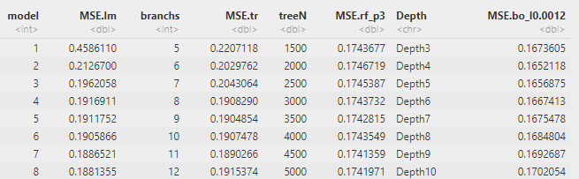
Model Comparison & Observations
Project Introduction
Data Overview
Best Select
Ridge & Lasso
Decision Tree
Random Forest & Boosting
Conclusion
• Accuracy
• Interpret ability

Slide 27
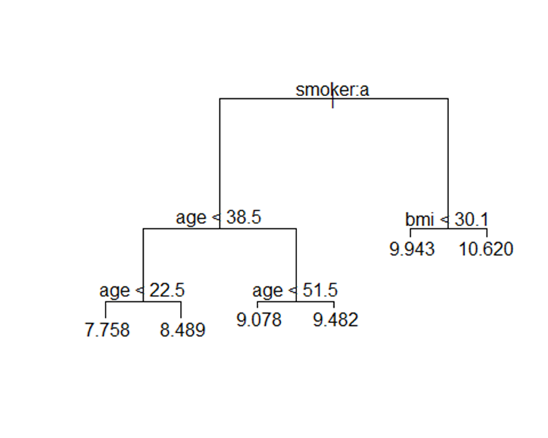
Final Model
Project Introduction
Data Overview
Best Select
Ridge & Lasso
Decision Tree
Random Forest & Boosting
Conclusion
Smoker: no
• Interpret ability
• Pruned tree with 6 branches
• Test MSE=0.2030
• Question:
Man, smoker, age 37, children 0 , BMI 32, Northeast

Slide 28
Final Model
Project Introduction
Data Overview
Best Select
Ridge & Lasso
Decision Tree
Random Forest & Boosting
Conclusion
Age & Sex: Significantly affects premiums
Long term: Different rates for each age and gender
Short term: In same level of age, premium are the same regardless of sex
BMI: May affect the underwriting results of long-term insurance, and may result in more premium or decline
Smoker: Usually affects premiums, but does not result in a decline
Children: Not that significant as other factors
Region: The partition is too broad, the difference is decreased
Smoker: no

Slide 29

Project Introduction
Data Overview
Best Select
Ridge & Lasso
Decision Tree
Random Forest & Boosting
Conclusion
Thank you !

